Slide 1
Unit:2 Optics
Interference and Diffraction
By
Dr.P.M.Patel

Slide 2
Techniques for obtaining Interference:
The phase relations between the waves emitted by two independent light sources rapidly changes with time and therefore, they can never be coherent
The source must be identical or coherent
The phase difference between the waves emerging from the two sources remains constant and the sources are coherent
The techniques used for creating coherent sources of light can be divided in to the following two classes:
Wavefront splitting
Amplitude splitting

Slide 3
1.Wavefront splitting:
In this methods light wave front emerging from a narrow slit pass through two closed slits. The two parts of the same wavefront travel through different paths and reunite on a screen to produce fringe pattern.
This is known as interference due to division of wavefront. This method is useful only with narrow sources.
Examples: Young’s double slits, Fresnel’s double mirror, Fresnel’s biprism, Loyed’ s mirror etc.

Slide 4
2.Amplitude splitting
The amplitude (intensity) of a light wave is divided into two parts as reflected and transmitted components, by partial reflection at a surface.
The two parts travel through different path and reunite to produced interference fringes.
It Is know as a interference due to division of amplitude.
Examples:
Optical elements such as beam splitters and mirrors
Interference in thin film like wedge shape, Newton’s ring
Michelson’s interferometer

Slide 5
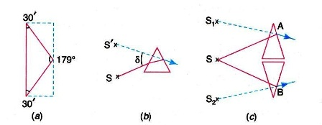
Fresnel Biprism:
Fresnel used a biprism to show interference phenomenon.
The biprism consists of two prisms of very small refracting angles joined base to base.
A thin glass plate is taken and one of its faces is ground and polished till a prism is formed with an angle of about 179⁰ and two side angles of the order of 30⁰.

Slide 6
When a light ray is incident on an ordinary prism, the ray is bent through an angle called the angle of deviation.
As a result, the ray emerging out of the prism appears to have emanated from a source S’ located at a small distance above the real source, as shown in figure 1b.
The prism produced a virtual image of the source.
A biprism creates two virtual sources S₁ and S₂ as shown in figure 1C. These two virtual sources are images of the same source S produced by refraction and are hence coherent.

Slide 7
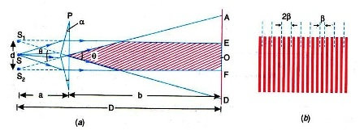
Experimental Arrangement:
The biprism is mounted suitably on an optical bench
A single cylindrical wavefront incident on both prisms.
The top portion of wavefront is refracted downward and appear to have emanated from the virtual image S₁
The lower segment, falling on the lower part of the biprism, is refracted upward and appears to have emanated from the virtual source S₂
The virtual sources S₁ and S₂ are coherent

Slide 8
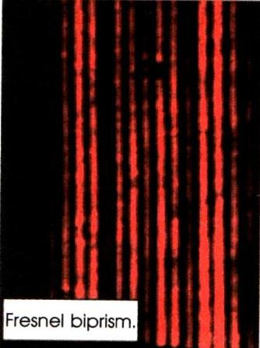

Experimental Fringes
Theory:
The width of the dark or bright fringe is given by
Where D = (a+b) is the distance of the source from the eyepiece

Slide 9

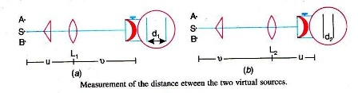
Determination of Wavelength of Light:
Adjustments:
Determination of fringe width β :
Determination of ‘d’:

Slide 10



The magnification is
where, u is the distance of the slit and v is the distance from the lens
The lens is then moved to a position nearer to the eyepiece, where again a pair of images of the slit is seen
The distance between the two sharp images is again measured. Let it be . Again magnification is given by

Slide 11

The value of d can be determined as follows. The deviation δ produced in the path of a ray by a thin prism is given by
Where is the refracting angle of the prism. From fig.2(a) it is seen that δ Since d is very small, we can write

Slide 12
Interference Fringes with White Light:
In the biprism experiment if the slit is illuminated by white light, the interference pattern consists of a central white fringe flanked on its both the sides by a few coloured fringes and generate illumination beyond the fringes. The central white fringe is the zero-order fringe. With monochromatic light all the bright fringes are of the same colour and it is not possible to locate the zero order fringe. Therefore, in order to locate the zero order fringe the biprism is to be illuminated by white light.

Slide 13
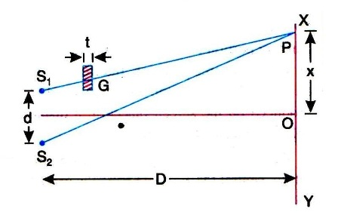
Lateral Displacement of Fringes:
The biprism experiment can be used to determine the thickness of a given thin sheet of transparent material such as glass or mica

Slide 14



The optical path
The optical path
The optical path difference at P is ,
since in the presence of the thin sheet the optical path lengths and are equal and central zero fringe is obtained at P.
Therefore,
But the path difference

Slide 15


where is the lateral shift of the central fringe due to the introduction of the thin sheet
Thus the thickness of the sheet is given as

Slide 16
Lloyd’s Single Mirror:
In 1834, Lloyd devised an interesting method of producing interference, using a single mirror and using almost grazing incidence. The Lloyd’s mirror consists of a plane mirror about 30cm in length and 6 to 8 cm in breadth as shown in fig.5
It is polished on the front surface and blacked at the back to avoid multiple reflections

Slide 17
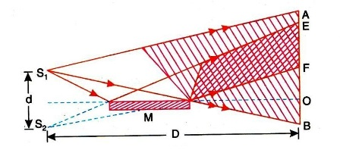

Determination of Wavelength:
The fringe width is given by
Measuring β, D and d the wavelength λ can be determined.

Slide 18
Comparison between the fringes produced by biprism and Lloyd’s mirror:
Sr No | Fresnel Biprism | Lloyd’s mirror
1 | The complete set of fringes is obtained | A few fringes on one side of the central fringe are observed and the central fringe being itself invisible
2 | The central fringe is bright | The central fringe is dark
3 | The central fringe is less sharp | The central fringe is sharp

Slide 19
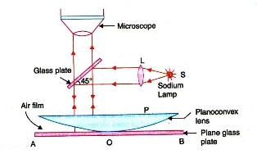
Newton’s Ring:
The experimental arrangement:

Slide 20
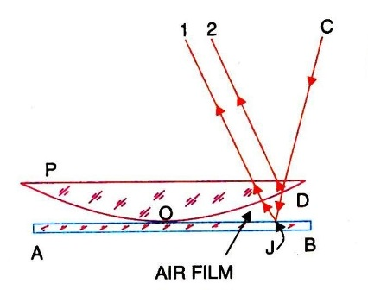
Division of amplitude taka place

Slide 21

Circular Fringes:
Newton originally observed these concentric circular fringes and hence they are called Newton’s rings

Slide 22

Conditions for Bright and Dark Rings:
The optical path difference between the rays is given by
But, for air and for normal incident
Therefore,
For maxima ,the optical path difference
It is equal to an integral number of full waves, then the rays meet each other in phase. The crests of one wave falls on the crests of the other and the waves interference constructively.

Slide 23


Therefore, or
This is the condition for obtaining bright fringe
The minima occur when the optical path difference is
The optical path between the two rays is equal to an odd integral number of half-waves, then the rays meet each other in opposite phase . The crest of one wave fall on the troughs of the other and the waves interfere destructively

Slide 24

Thus, or
This is the condition for producing dark fringe

Slide 25
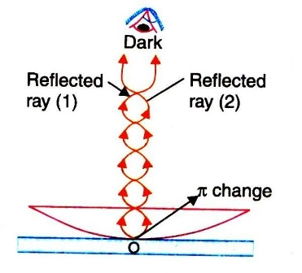

Slide 26
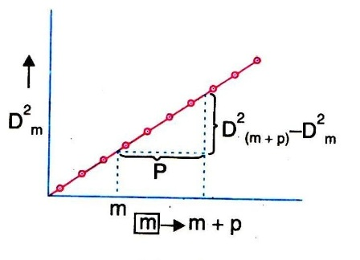
Determination of wavelength of Light:

Slide 27



Determination of wavelength of Light:
we have,
The slope of the straight line gives the value of 4λR .
The radius of curvature R of the lens may be determined using a sphectrometer and λis computed with the help of the above equation.

Slide 28
Multiple Reflections from a Plane Parallel Film:
The high order reflection occurring at interfaces of thin film are negligible.
But, if for any reason the reflection of the interface is not negligible, then the higher order reflections are to be taken into account.
When the reflected or transmitted beams meet, multiple beam interference takes place. We are especially interested in the fringes associated with the air space between two reflecting surfaces.

Slide 29
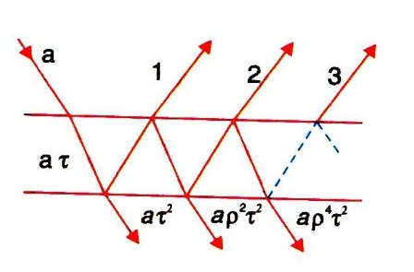

Slide 30

The amplitude coefficient of reflection is
If the film does not absorb light, the amplitudes of the reflected and transmitted waves are and respectively.

Slide 31
INTENSITY DISTRIBUTION:
Let a be the amplitude of the light incident on the first surface.
A certain fraction of this light aρ, is refracted and another fraction, aτ is transmitted
ρ is the amplitude reflection coefficient
τ is the amplitude transmission coefficient
Again at the second surface, part of the light is refracted with amplitude aρ² and part is transmitted with amplitude aτ² . The next ray is transmitted with an amplitude aρ²τ² , the next one with after that with aρ⁴τ² and so on.

Slide 32
If T and R be the fractions of the incident light intensity which are respectively transmitted and refracted at each silvered surface
Then τ² = T and ρ² = R .
The amplitude of the successive rays transmitted through the pair of plates will be
aT, aTR, aTR² , ……..
In complex notation , the incident amplitude is given by

Slide 33
Then the waves reaching a point on the screen will be
By the principle of superposition, the resultant amplitude is given by

Slide 34
Using this expression for sum of the terms of a geometrical progression, we get
A=
When the number of terms in the above expression approaches infinity, the term R^{N} tends to zero, and the transmitted amplitude reduces to

Slide 35
The complex conjugate of A is given by
The transmitted energy I_{T} = AA*
I_{T}

Slide 36
The intensity will be maximum when sin² =0 ,
i.e. δ= 2mπ, where m= 0,1,2,3,4,5,.
Thus,
The intensity will be a minimum, when sin² =1
i.e. =(2m+1)π, where m= 0,1,2,3,4,5,
Thus,

Slide 37
Transmitted energy
The interference intensity from the reflected light is

Slide 38
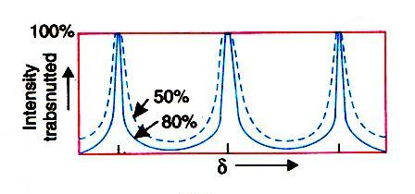
SHARPNESS OF THE FRINGES:

Slide 39
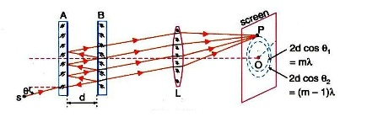
Fabry- Perot Interferometer and Etalon
The Fabry- Perot Interferometer is a high resolving
power instrument, which makes use of the fringes of
equal inclination, produced by transmitted light
after multiple reflections in an air film between the
two parallel highly reflecting glass plates.

Slide 40
Theory:
The interferometer consists of two optically plane glass plates A and B with their inner surfaces silvered
Placed accurately parallel to each other.
Screws are provided to secure parallelism if disturbed
This system is difficult to manufacture and is no more in use.
Instead of it an etalon which is more easily manufactured is used.

Slide 41
The etalon consists of two semi-silvered plates rigidly held parallel at a fixed distance apart
The reflectance of the two surfaces can be as high as 90 to 99%.
The reflected and transmitted beams interfere with each other
The Fabry-Perot interferometer is usually used in the transmissive mode
S is a broad source of monochromatic light and L₁ convex lens, which is not shown in the figure, but which makes the rays parallel.

Slide 42
An incident ray suffers a large number of internal reflections successively at the two silvered surfaces
At each reflection a small fraction of light is transmitted
Thus each incident ray produces a group of coherent and parallel transmitted rays with a constant path difference between any two successive rays.
A second convex lens L brings these rays together to a point in its focal plane where they interfere.
Hence the rays from all points of the source produce an interference pattern on a screen placed in the focal plane of the lens.

Slide 43
Formation of Fringes:
Let d be the separation between the two silvered surfaces
θ the inclination of particular ray with the normal to the plates.
The path difference between any two successive transmitted rays is 2dcosθ
The condition for maximum intensity is given by
2dcosθ = mλ
Here m is an integer.

Slide 44
Determination of Wavelength:
When the reflecting surface A and B of the interferometer are adjusted exactly parallel, circular fringes are obtained.
Let m be the order of the bright fringe at the centre of the fringe system. As at the centre θ=0, we have 2t = mλ
If the movable plate is moved a distance λ/ 2, 2t changes by λ and hence a bright fringe of the next order appears at the centre. If the movable plate is moved from the position x₁ to x₂ and the number of fringes appearing at the centre during this movement is N then
Measuring x₁ , x₂ and N one can determine the value of λ

Slide 45
Measurement of Difference in Wavelength:
The light emitted by a source may consist of two or more wavelengths, D1 and D2 lines in case of sodium.
Separate fringe patterns corresponding to the two wavelengths are not produced in Michelson interferometer.
Hence, Michelson interferometer is not suitable to study the fine structure of spectral lines.
In Fabry- Perot interferometer, each wavelength produces its own ring pattern and the patterns are separated from each other.
Therefore, Fabry-Perot interferometer is suitable to study the fine structure of spectral lines.

Slide 46
Let λ₁ and λ₂ be two very close wavelengths in the incident light.
Let us assume that
Initially, the two plates of the interferometer are brought into contact.
Then the rings due to λ₁ and λ₂ coincide partially.
Then the movable plate is slowly moved away such that the ring systems separate and maximum discordance occurs.
Then the rings due to λ₂ are half way between those due to λ₁ .

Slide 47
Let t₁ be the separation between the plates when maximum discordance occurs.
At the centre

Slide 48
Using this value of m₁ in equation (21), we get

Slide 49
When the separation between the plates is further increased, the ring systems coincide again and the separate out and maximum discordance occurs once again.
If t₂ is the thickness now,

